Slide 1
Visual Semantic Search Case Study
Vaibhava Poojary
AI-ML Engineer

Slide 2
Problem Statement
Challenges in image search and retrieval today
Need for semantic, content-based search rather than keyword
Importance for healthcare or domain-specific image repositories

Slide 3
Solution Overview
Deployable AI-powered visual semantic search system
Combines state-of-the-art vision-language model (OpenAI CLIP) + vector indexing (FAISS)
Full-stack solution with backend API, scalable frontend, and cloud deployment

Slide 4
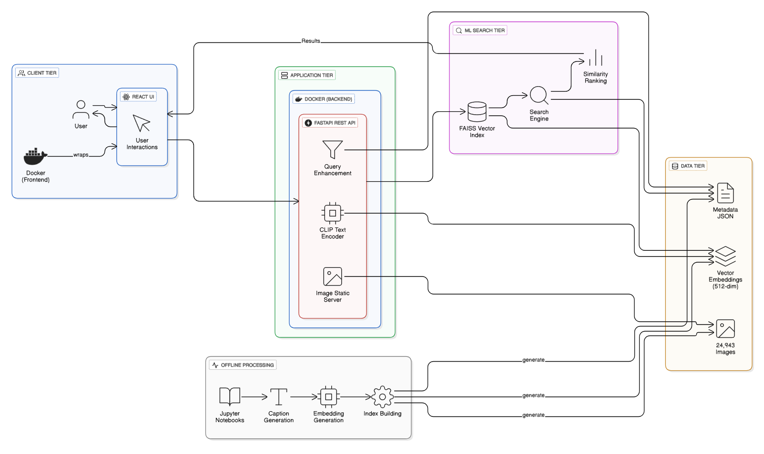
System Architecture Design

Slide 5
Data Flow and Interaction
User submits query through frontend UI
Query sent to backend API (/search)
Backend uses CLIP to encode text/image and FAISS index to find relevant images
Results returned and displayed

Slide 6
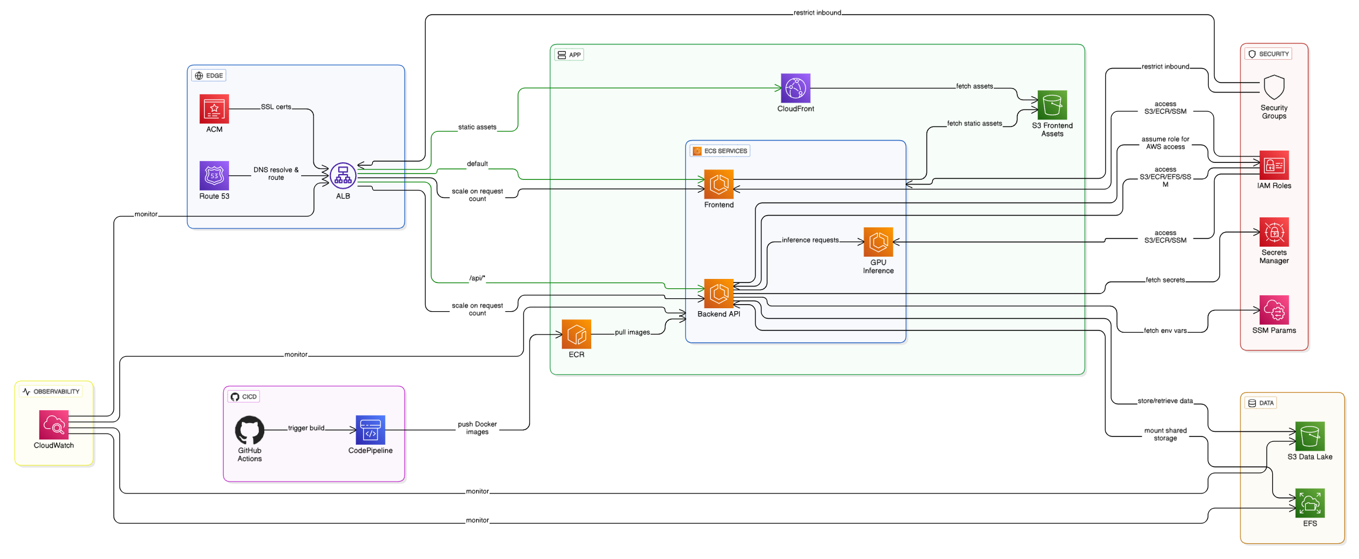
Cloud Architecture and Deployment Process

Slide 7
Technology Stack
React, Vite, TypeScript for frontend
Python Fast API for backend API
OpenAI CLIP model for visual language embeddings
FAISS for efficient similarity search
AWS Cloud: ECS, ECR, S3, EFS, ALB, Route 53, ACM, CloudWatch
Docker containerization and orchestration

Slide 8
Key Benefits and Differentiators
AI-powered semantic search providing relevant results beyond keywords
Fully containerized, scalable cloud architecture
Modular design allowing substitution of components (models, infra)
Robust deployment pipeline for rapid iteration and updates
Cost and reliability considerations

Slide 9
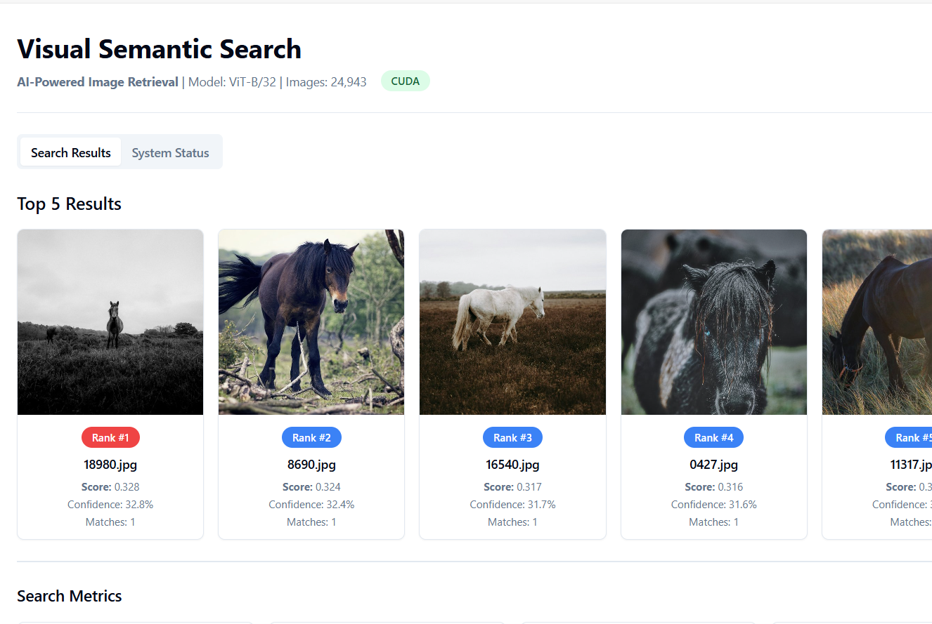
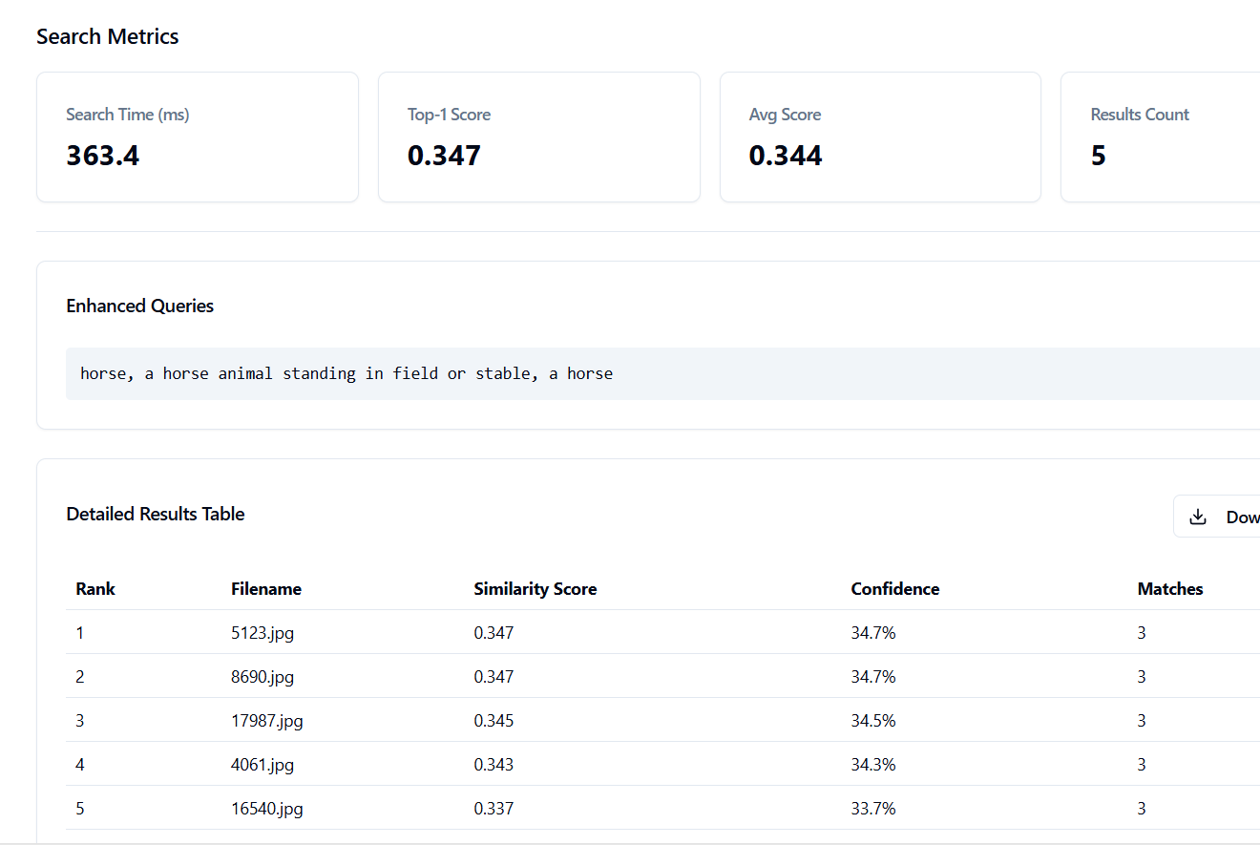
Demo / Screenshots

Slide 10
Future Enhancements
GPU-backed inference for faster model processing
Multi-modal queries (text + image)
Expanded dataset with healthcare or domain-specific images
User feedback-driven search refinement
Integration with analytics and reporting

Slide 11
Thank You

